Slide 1


Information Extraction and Aggregation
from Unstructured Web Data
for Business Profiling
Student Team : Alexander Michels, Himanshu Ahuja
Industry Mentors : Dr. Stephen DeSalvo, Urjit Patel

Slide 2



Determining Risks
Praedicat: An Insurance Tech Company
Determining Risk
Ethylene glycol
moderately toxic
generally used in anti-freeze
[1] https://iaspub.epa.gov/triexplorer/release_fac_profile?TRI=38063MRCNG1236A&TRILIB=TRIQ1&FLD=&FLD=RELLBY&FLD=TSFDSP&OFFDISPD=&OTHDISPD=&ONDISPD=&OTHOFFD=&YEAR=2016
Notes:
Simple. EPA tells us. No parent company.

Slide 3





Determining Risks
Praedicat: An Insurance Tech Company
Predicting the likely amount of losses
Notes:
Simple. EPA tells us. No parent company.
Praedicat's goal is to understand the financial impact each business practice has on a company's profits and how these practices correlate profits between businesses.
One wouldn't expect major lawsuits against an anti-freeze producer to impact a greeting card manufacturer, but it does.

Slide 4




Where Do We Fit in?
RIPS Team
Automating
1. Manual Search
2. Credible Database
3. Forward-looking Models
4. Predict Likely Losses
Notes:
Praedicat, Inc. is an InsurTech that is doing ground-breaking work in risk-analysis by modeling the state and evolution of scientific literature to characterize the risk. Their goal is to make the world cleaner, safer, and healthier by identifying the emerging risk using the methodology based on the peer-reviewed scientific literature. By mining peer-reviewed science journals they are able to anticipate tomorrow's claims.

Slide 5


Difficulty of Searching Information
Q1: What does Company X do?
Structured
- Government Filings
- www.companyx.com
Q2: Does Company X use hazardous chemicals to produce its products?
- News
Bloomberg
CNN
NYTimes
- …..............
Unstructured

Slide 6
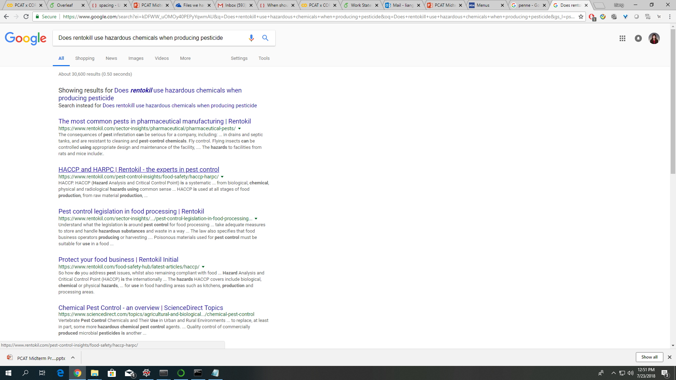
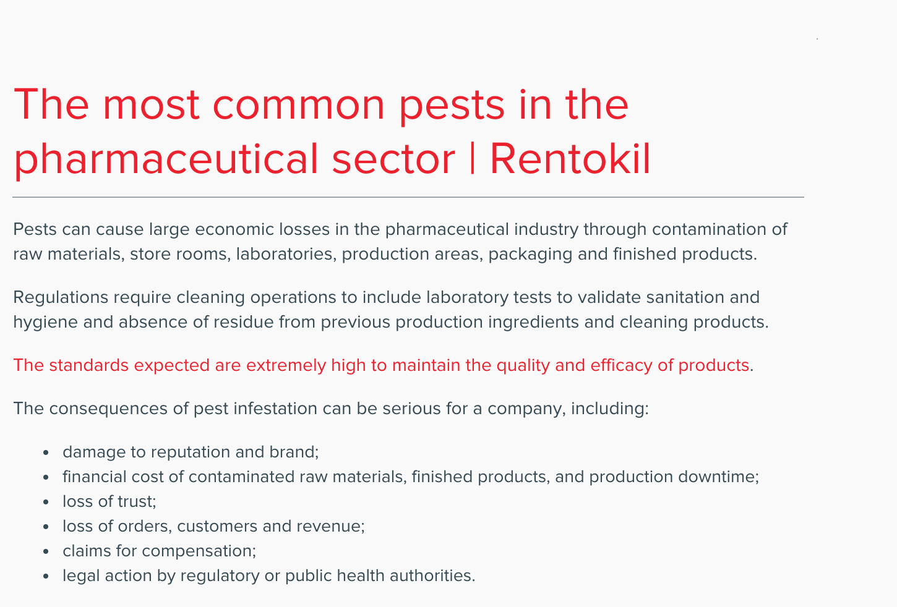
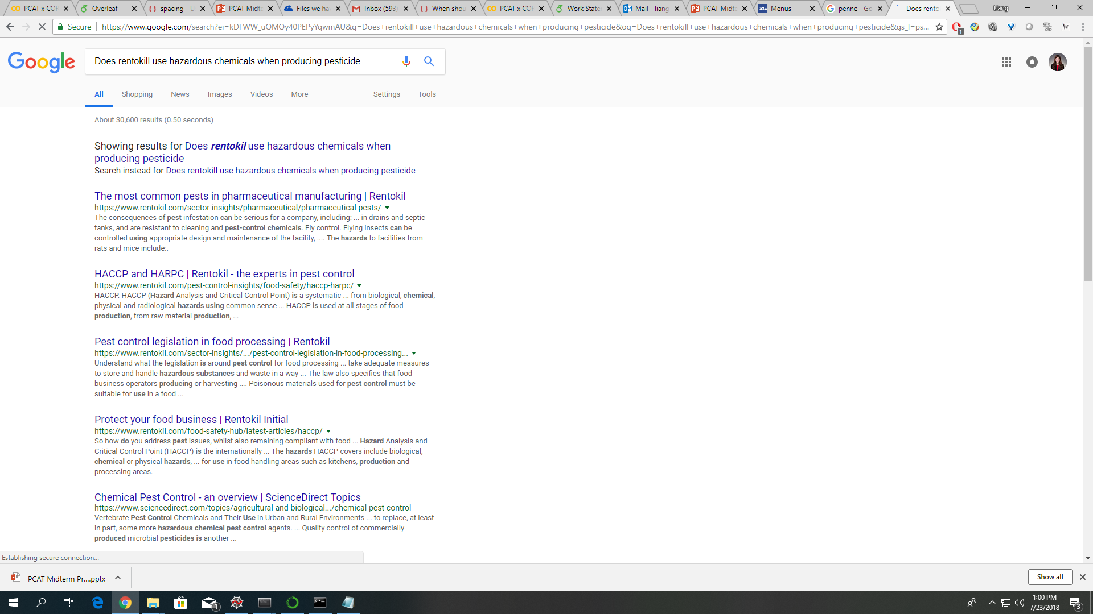
Difficulty of Searching Information
1. Search Engine
Change
Keywords
2. Site Search
3. Evaluate Contents

Slide 7
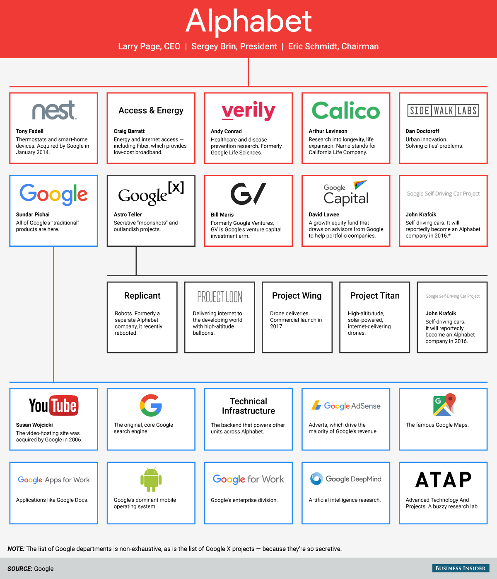
Difficulty of Allocating Risk
Example: Allocating Risk for Parent and Subsidiary Companies
Parent Company
Parent Company
Subsidiary Company
Notes:
Subsidiary structures make the problem even more complex as a company may be held liable for something they don't directly engage in.
For example, Alphabet may be held liable for one of Project Wing's drones crashing and causing damage even though Alphabet doesn't directly fly drones.

Slide 8
Problem Statement
How to automate information extraction and aggregation from unstructured data on the Internet
for business profiling
Notes:
Right now their assessment of risk is based on proprietary algorithms that extract information on business practices and chemicals from over 10,000 peer-reviewed journals and from regulatory documents, but there is a lot more information out there. There are news articles and tons of other documents freely available on the internet, but of course the problem is that unlike the peer-reviewed journals Praedicat generally works with, the data on the web is generally unstructured, the credibility is questionable, and the conclusions are a bit harder to draw. In a broad sense, we are helping Praedicat first find relevant information on the web by building a web crawler, and from there we need to use Natural Language Processing to process the data with the hopes we can come up with data that is useable for the Praedicat models.

Slide 9
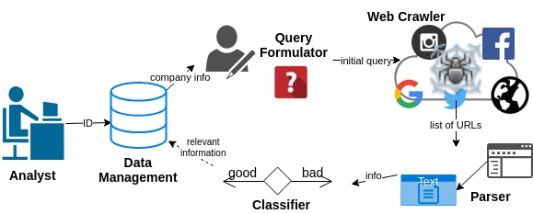
Solution Overview

Slide 10
Solution Overview

Slide 11
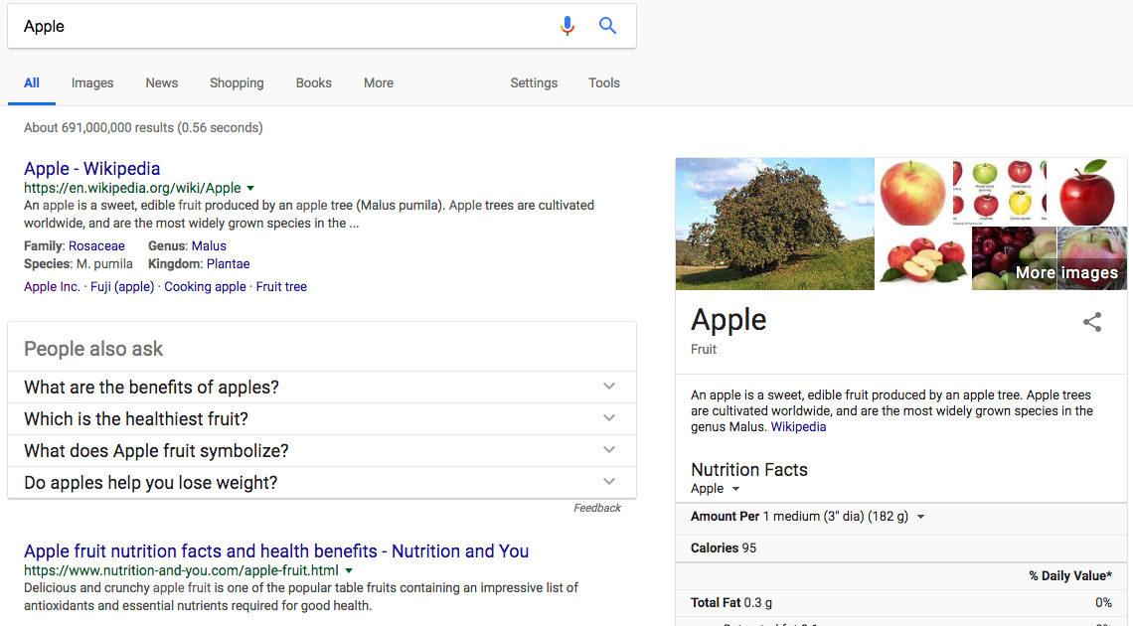
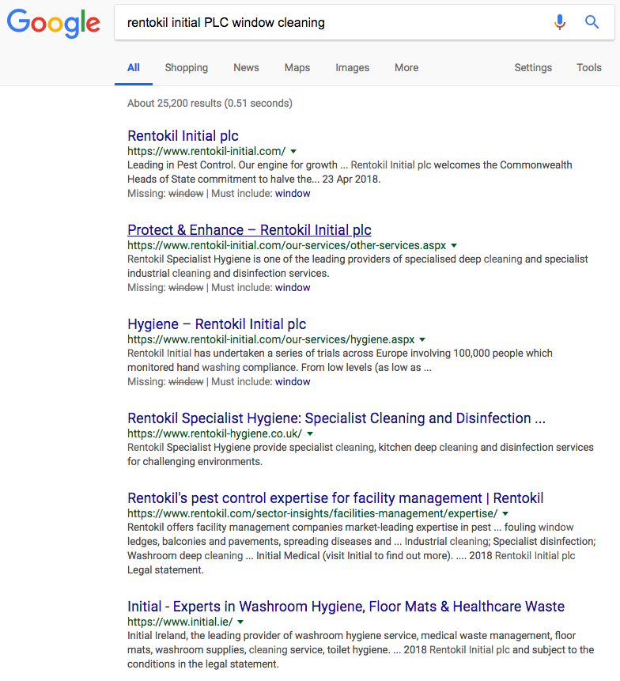
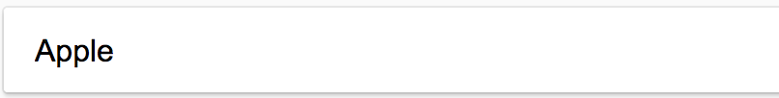
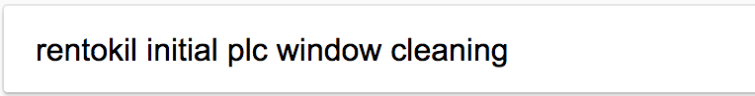
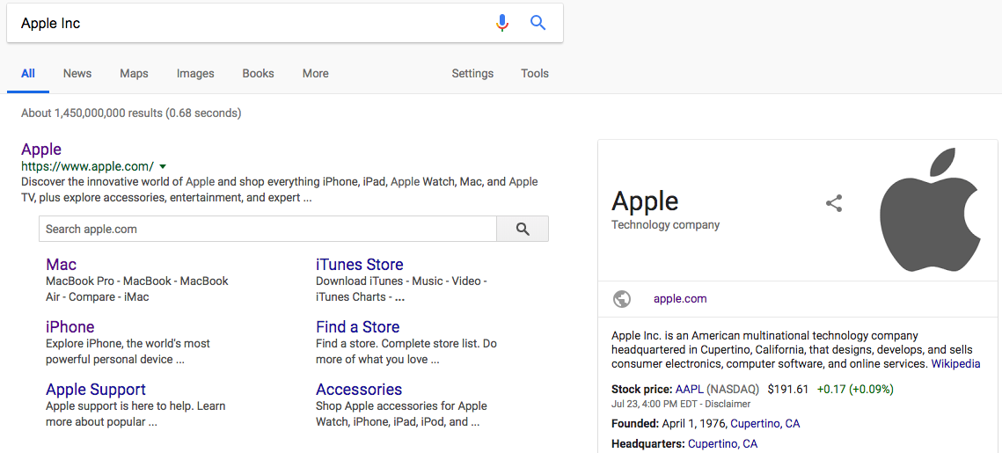
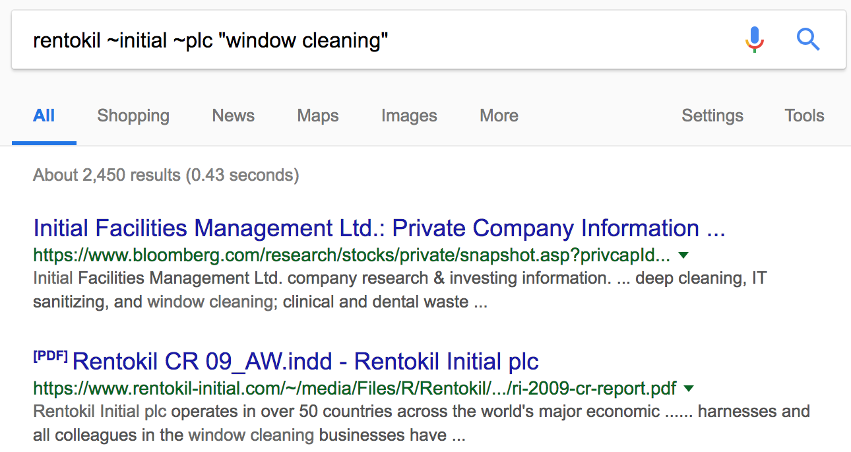
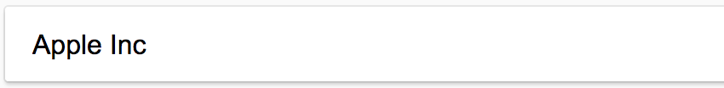
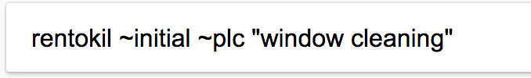
Query Formulator: Asking about the right things!
Zero useful results
‘Apple Inc.’ returns the right results.
PDF result mentions Rentokil Initial PLC involvement in window cleaning.

Slide 12
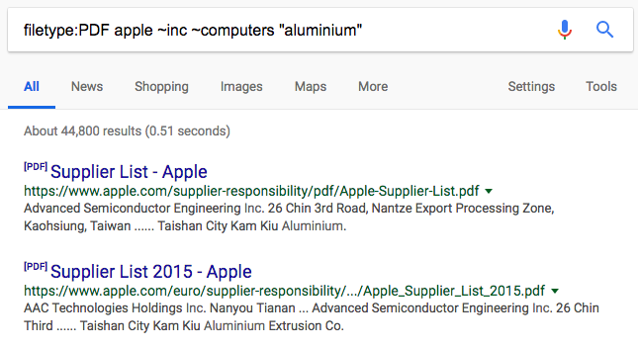
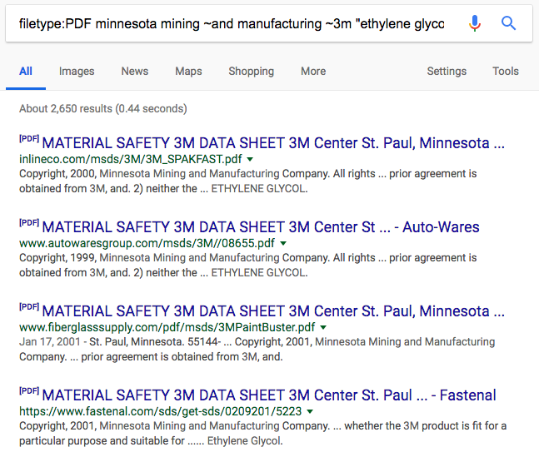
Query Formulator: How did we ask the right things?
Making some words optional
Mention the file-type
Making keywords mandatory
Name of the company
Optional alias

Slide 13
Solution Overview

Slide 14
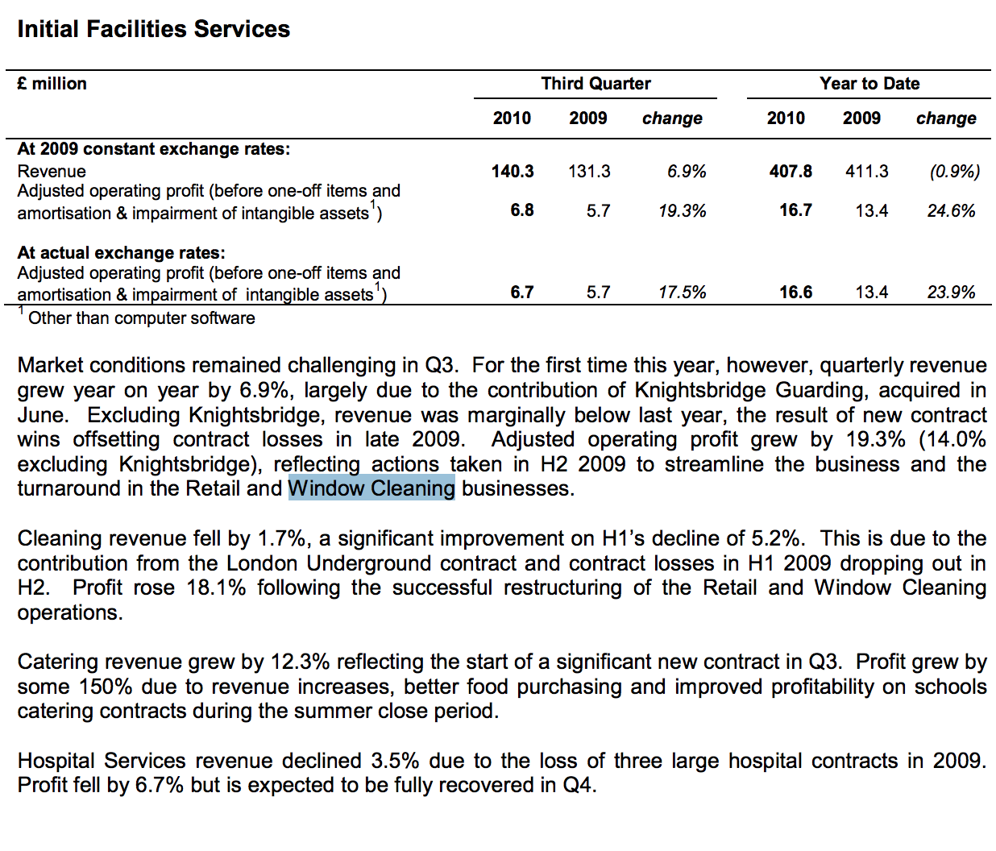

Web Crawling: What is web Crawling?
Start
End
Notes:
SCRAPING IN A WAY, THAT WE GET TO THE DESIRED WEBSITE.

Slide 15
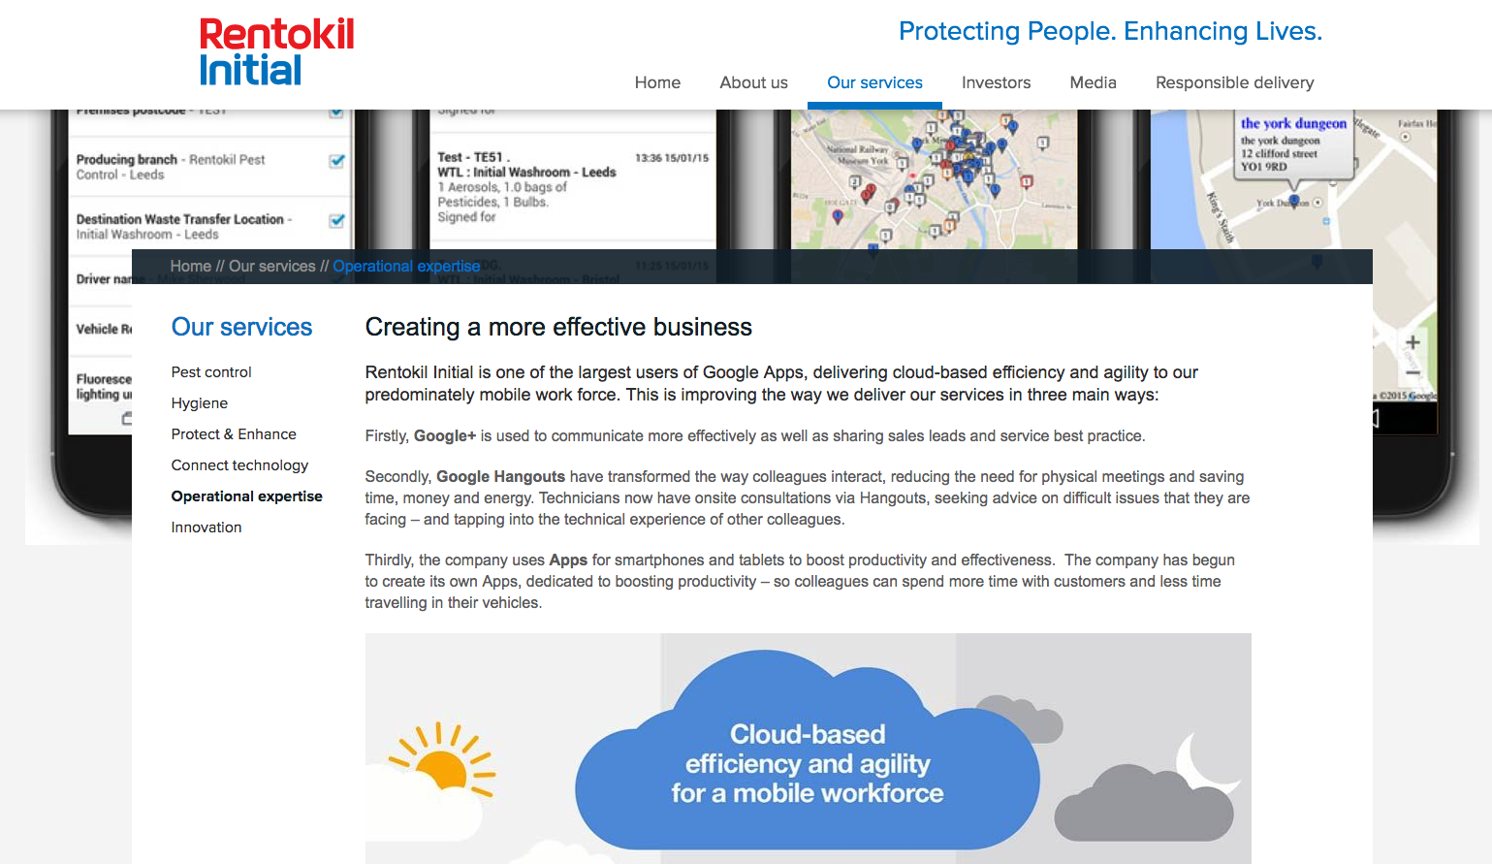
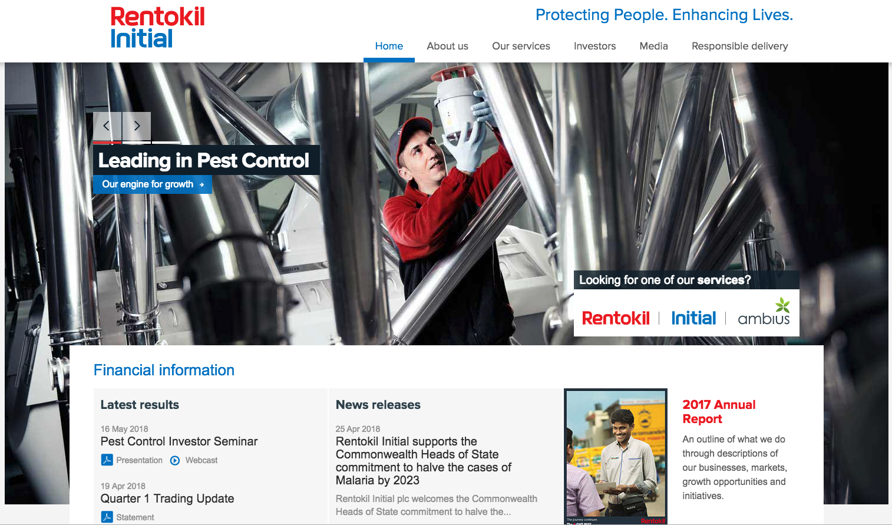
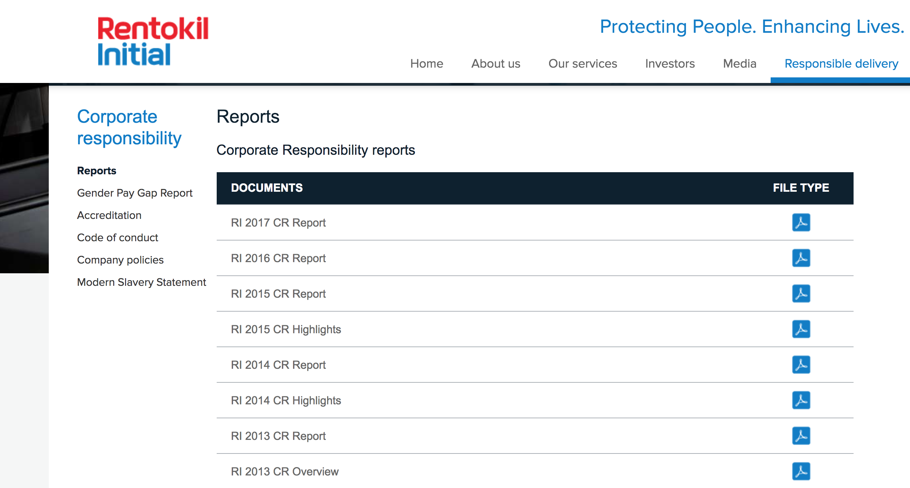
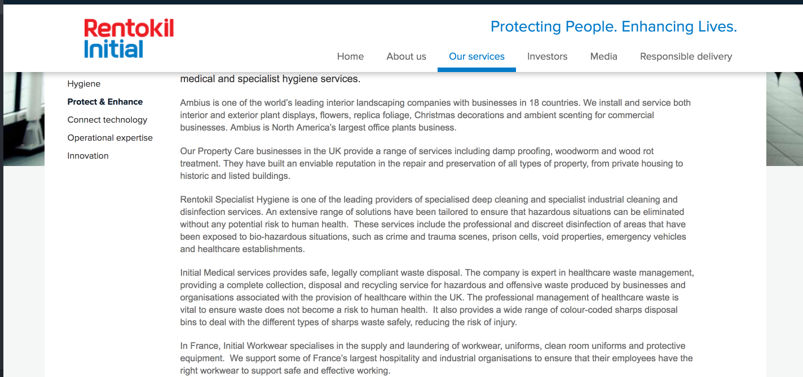
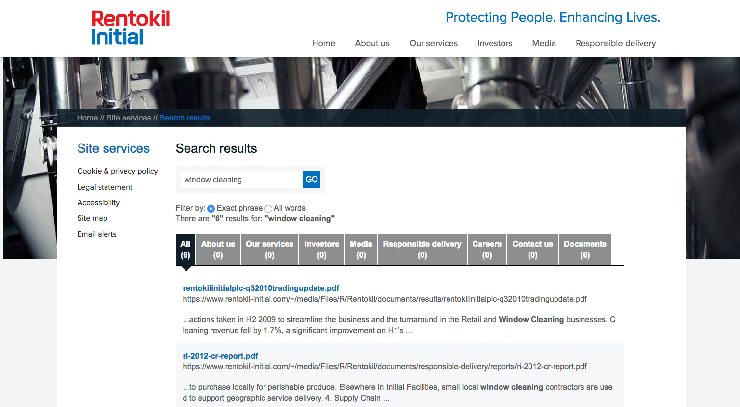
Web Crawling: Unsupervised machines cannot be trusted
End
Start
The business activity appears in the financial report that specifically appears on search services provided by the website.
Start with a google search of the company and its business activity.
Notes:
SCRAPING IN A WAY, THAT WE GET TO THE DESIRED WEBSITE.

Slide 16
Web Crawling: Where and how far?
The problem:
We don’t know how far to dig, and where to dig?
We don’t know the credible sources and where the information lies on the credible sources.

Slide 17
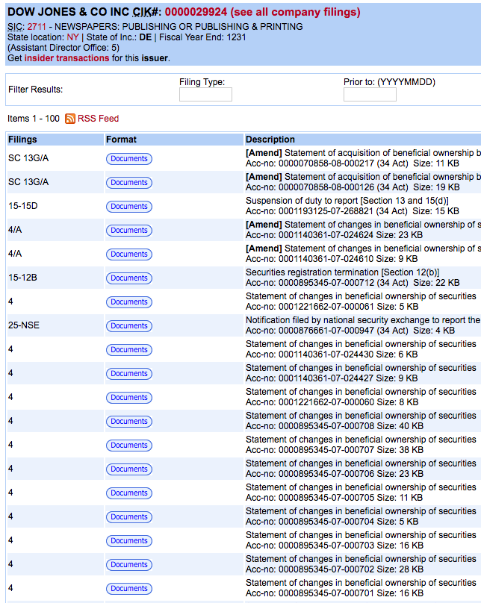
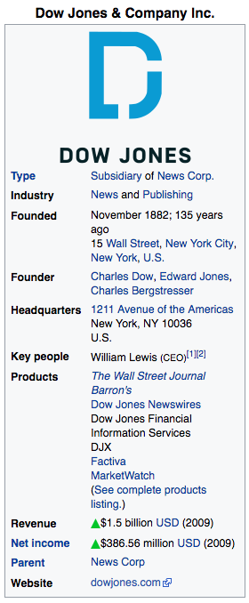
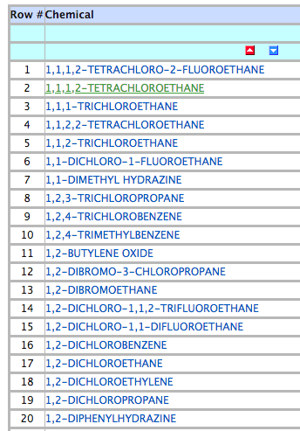
Web Crawling: Credible data to the rescue
Interestingly the structured data (available on Federal websites & Wikipedia) is also credible!
Design of specific crawlers to get data from specific types of data.
Create the baseline data.

Slide 18
Solution Overview

Slide 19
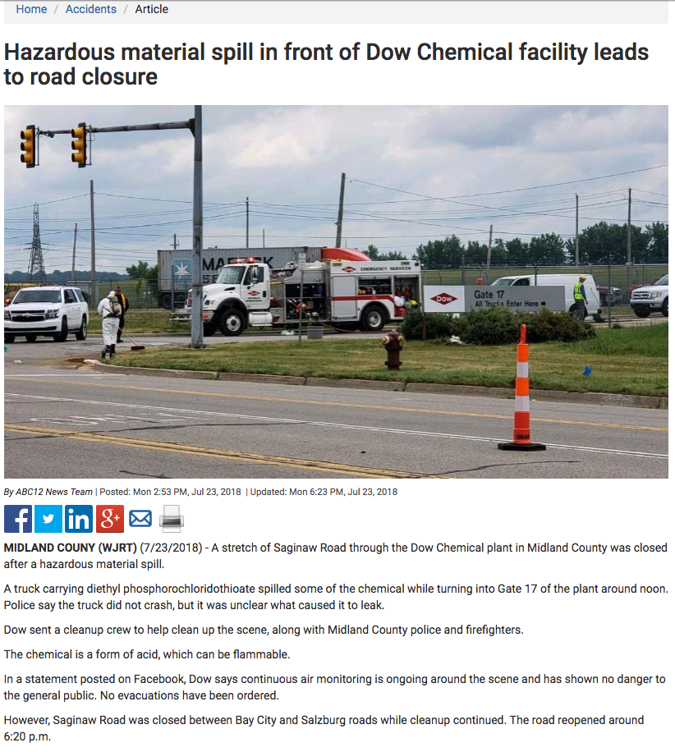
Parser:
Getting unstructured data
Use of text abundance to locate meaningful paragraphs.
Filtering out tags containing social media redirects.
Removing graphic contents, advertisements.

Slide 20
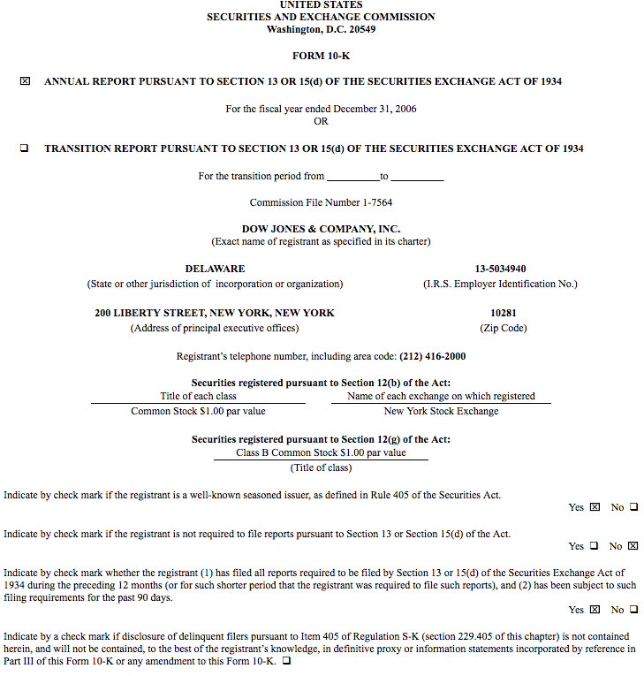
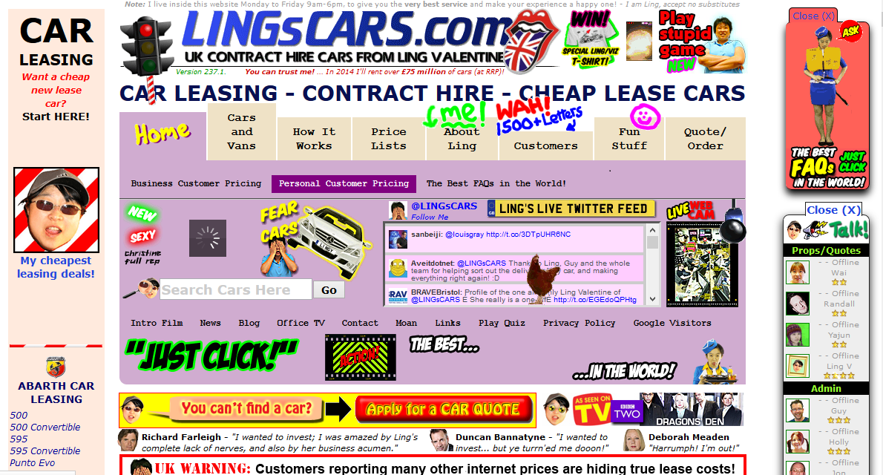
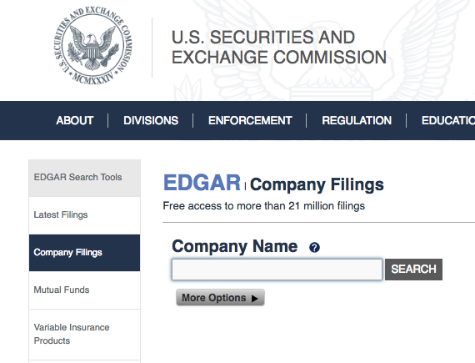
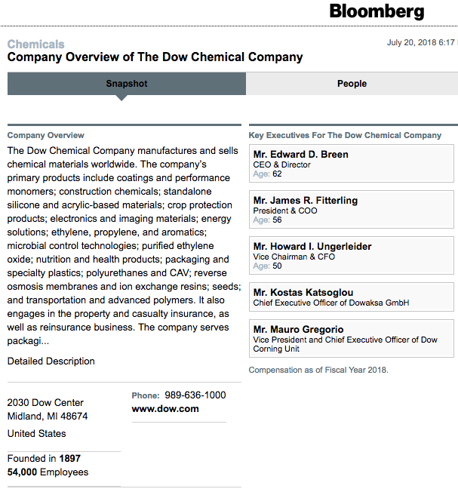
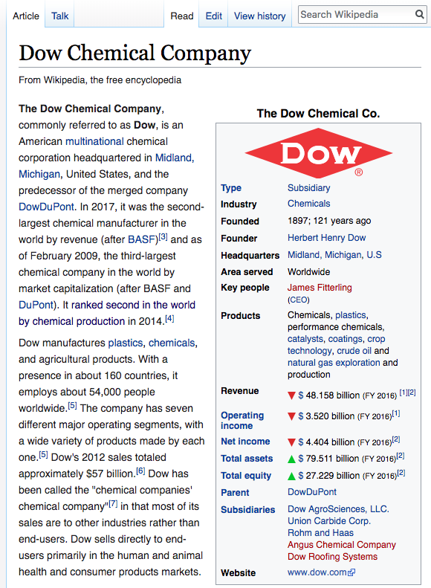
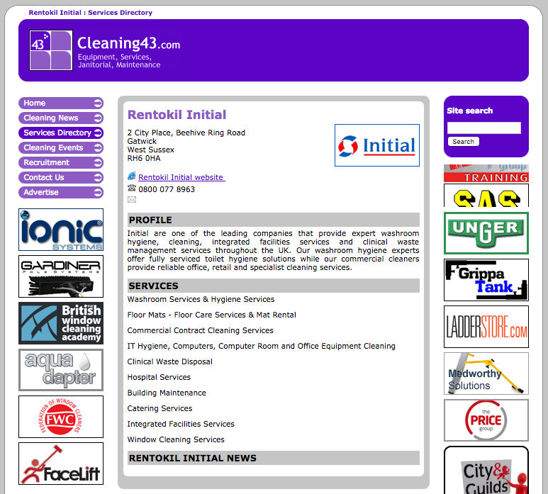
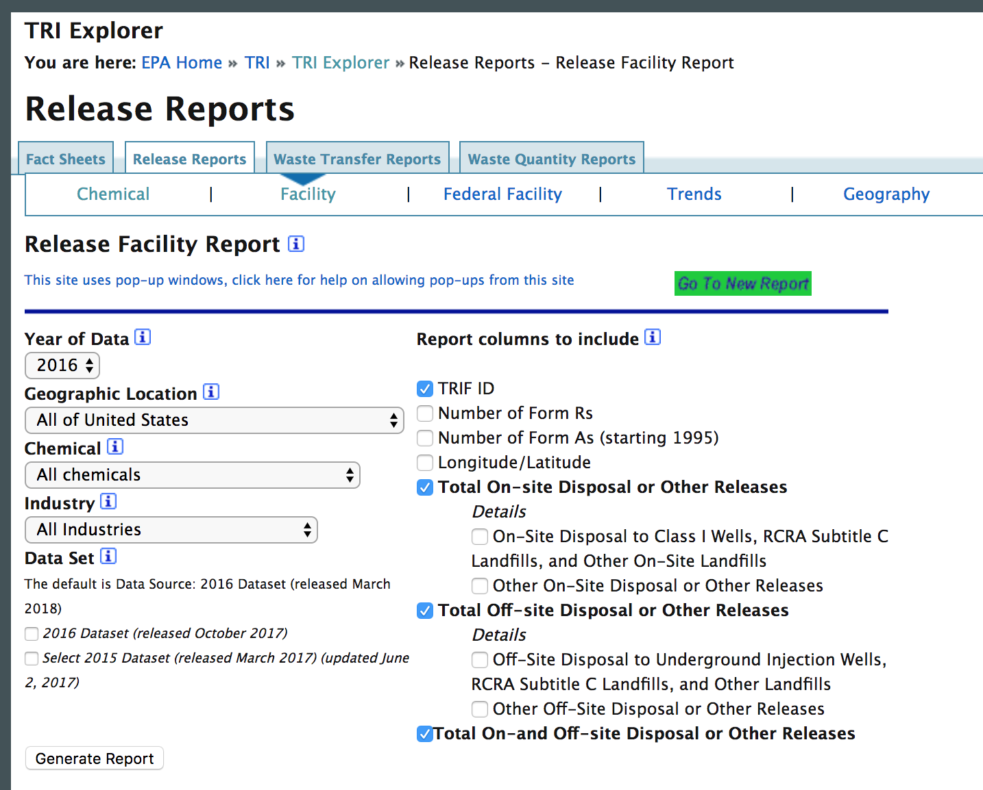
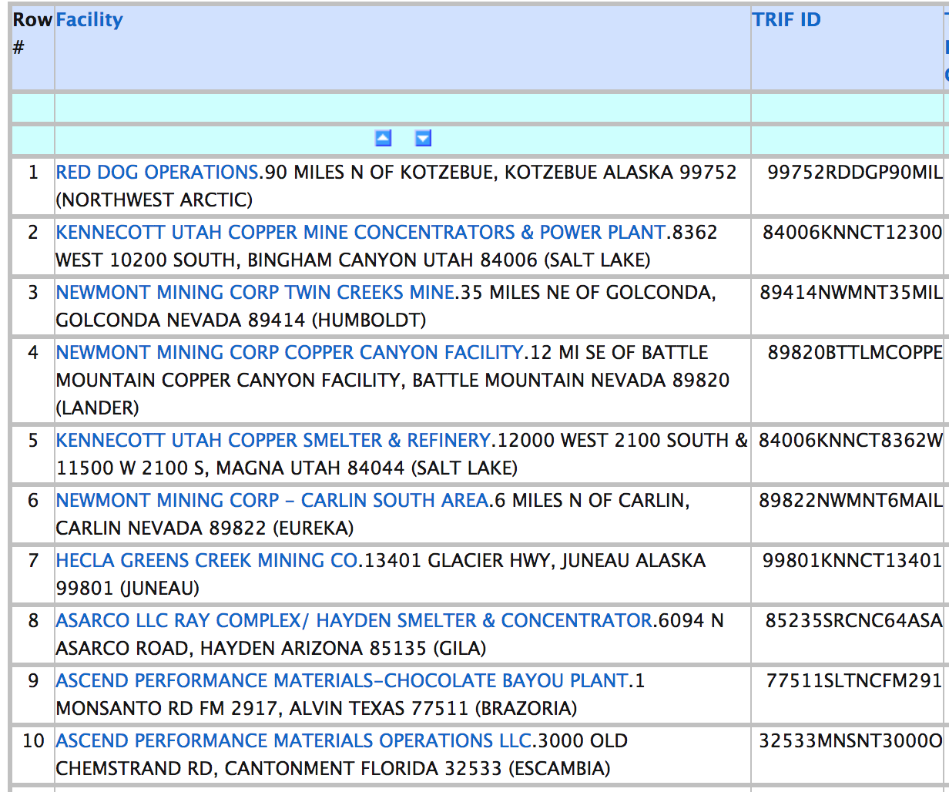
Parser: Why go towards unstructured data?
Annual Report
SEC
TRI
Facility Report
More credible information
More indicative information
Structured Data
Unstructured data
Lower volume of data
Higher volume of data
Notes:
Securities and Exhange Comission
Toxic Release Inventory Program

Slide 21
Solution Overview

Slide 22




Classifiers
Our web crawlers and parsers can give us a huge quantity of data, but not all sources are created the same.
Our web crawler needs to distinguish between high quality data and YouTube comments.

Slide 23
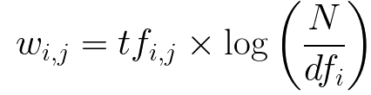

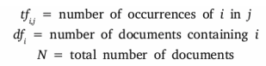
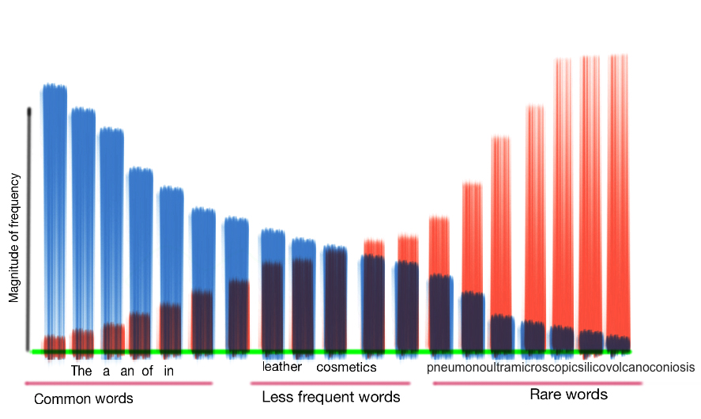
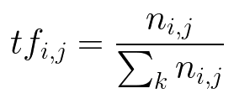
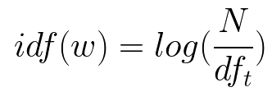
Term Frequency-Inverse Document Frequency (TF-IDF)
Each term (word, i ) in a document (j) has its own term frequency (tf)
Each word has an inverse-document frequency (idf), which

Slide 24
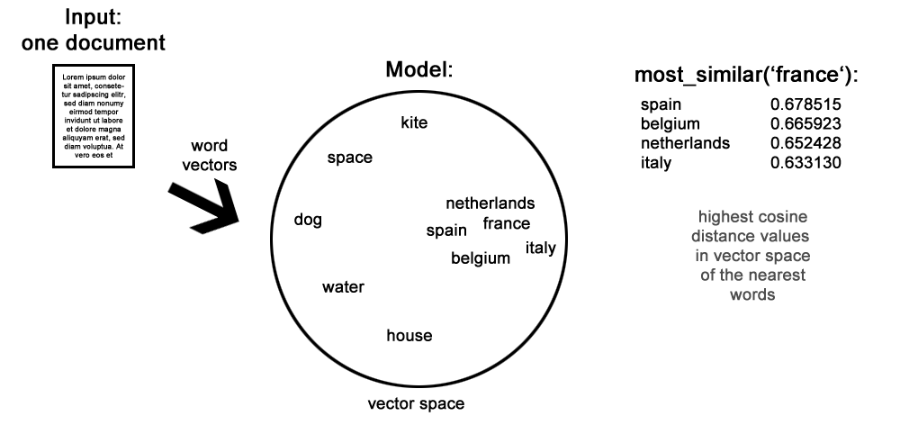
Keyword Generation with word2vec
Notes:
Keyword generation for query formulation using word2vec.
In reality, because of how sporadic the information is and the inability to perform supervised learning, we have not found a need for query formulation yet.

Slide 25
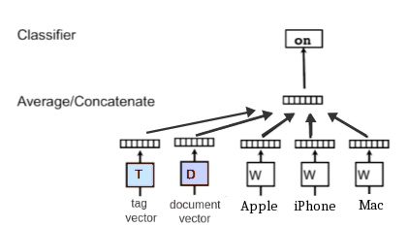
doc2vec
Doc2vec uses a Distributed Memory version of Paragraph Vector (PV-DM)
You can "tag" documents with topics.
We can attempt to cluster or classify documents using tags.

Slide 26
Solution Overview

Slide 27
Data Management
Many companies can't make use of their data
Our data needs to be:
Traceable back to the source
Queryable
Our solution: ProfileManager and WebResourceManager.

Slide 28

The Story So Far...
Our web crawling and parsing capabilities are bottlenecked by our ability to classify information.
We currently have a database of high-credibility information about 52,629 companies and corporate entities including:
10Ks
8Ks
EX21s
Wikipedia
Notes:
Right now their assessment of risk is based on proprietary algorithms that extract information on business practices and chemicals from over 10,000 peer-reviewed journals and from regulatory documents, but there is a lot more information out there. There are news articles and tons of other documents freely available on the internet, but of course the problem is that unlike the peer-reviewed journals Praedicat generally works with, the data on the web is generally unstructured, the credibility is questionable, and the conclusions are a bit harder to draw. In a broad sense, we are helping Praedicat first find relevant information on the web by building a web crawler, and from there we need to use Natural Language Processing to process the data with the hopes we can come up with data that is useable for the Praedicat models.

Slide 29
Going Forward

Slide 30
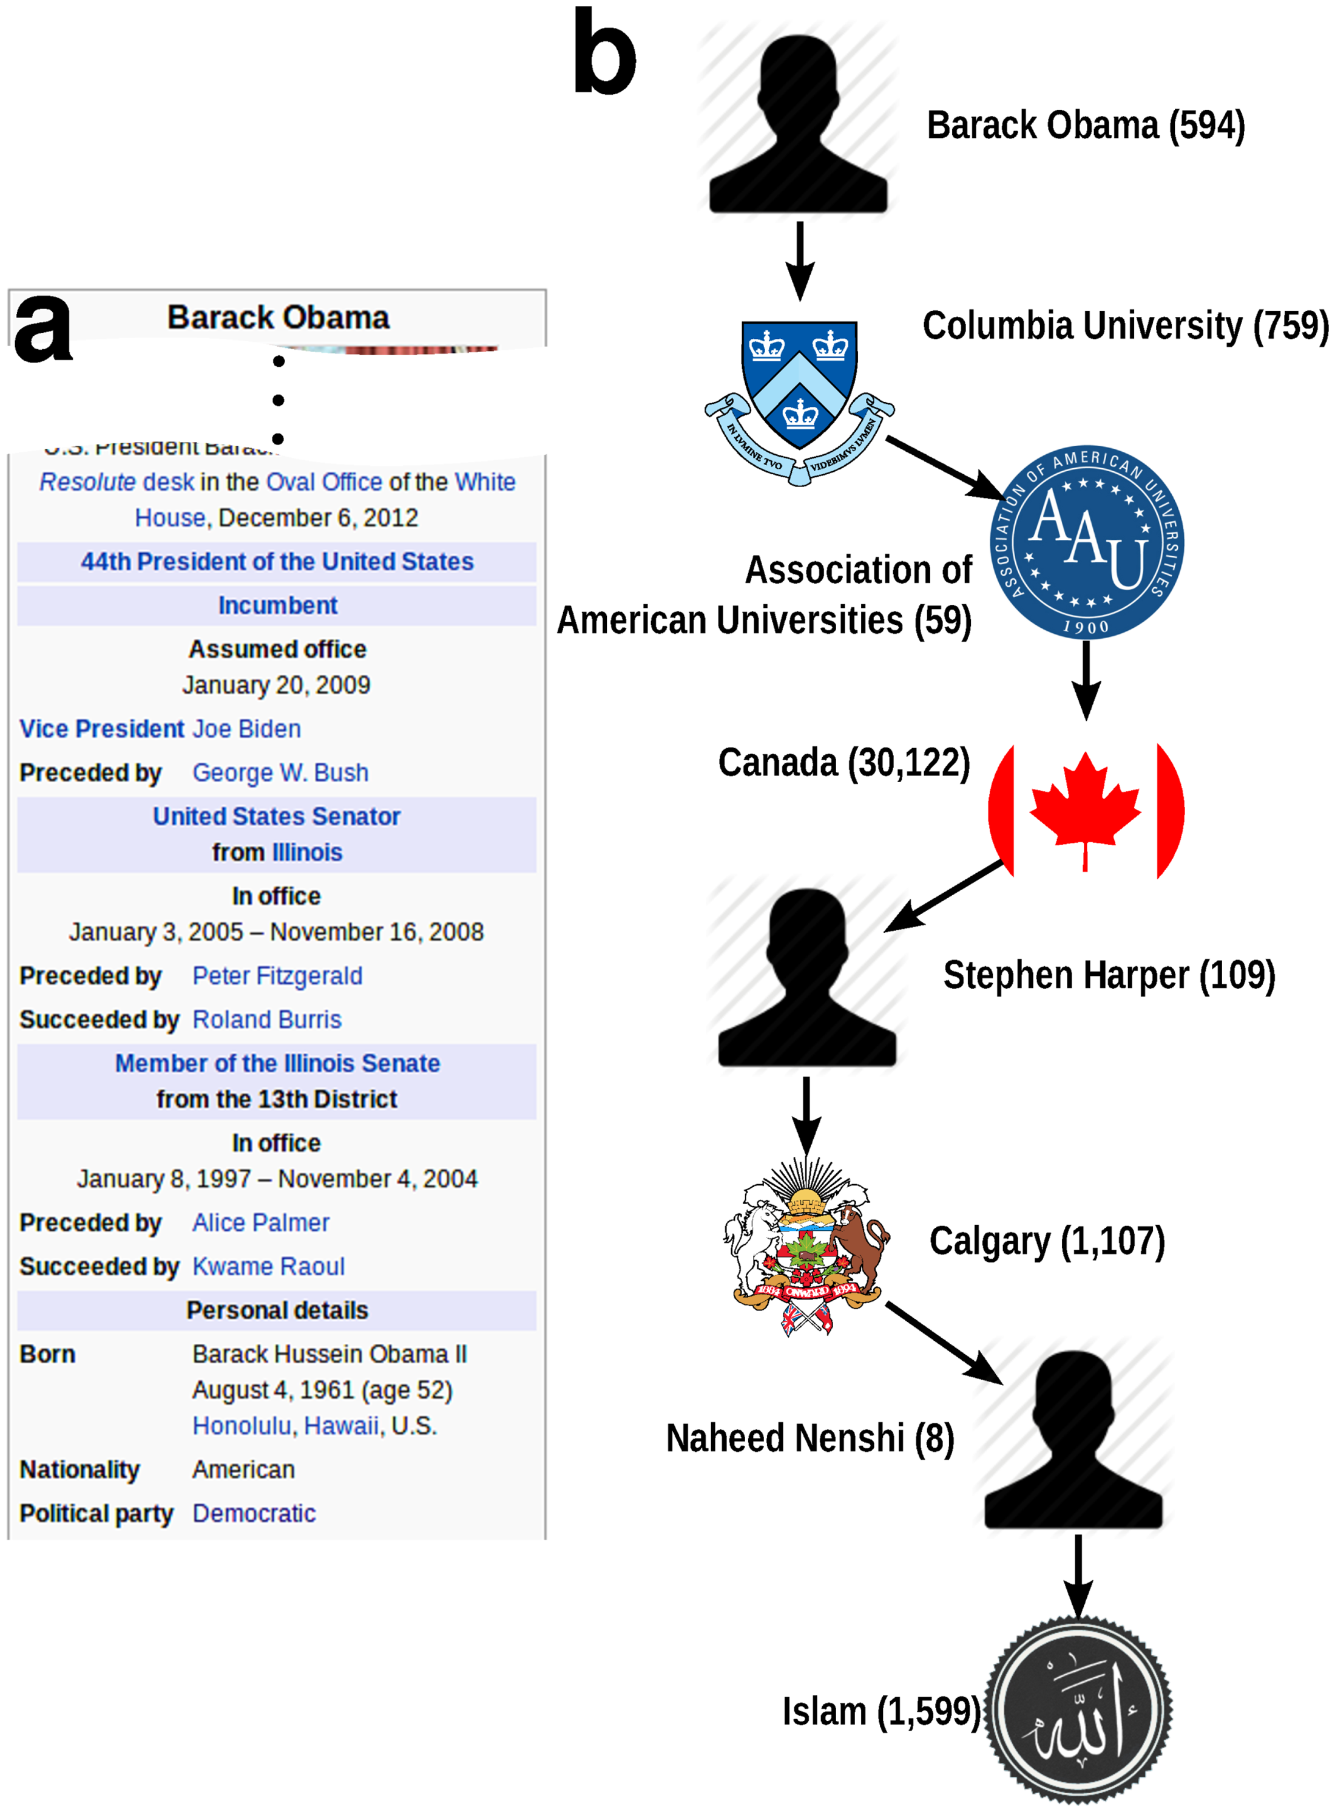
Knowledge Graph
Knowledge graphs represent statements of facts as subject-predicate-object triples
For example ("Barack Obama", "is a", "Muslim")
G=(V,E) where V is a set of concept nodes and E is a set of predicate edges
To determine the degree of truth of a statement of fact, the shortest path from subject to object is traversed and paths that pass through high-degree nodes are assigned a low truth value

Slide 31
How we are hoping to use the knowledge graph
Credibility Checking and Classification
A document that contains a statement of fact P that is contradictory to the set of possible-worlds as described by our knowledge graph is rejected.
We can also use competitive learning to prioritize trustworthy sources.
Aggregates Information in a Queryable Format
This makes the information much more accessible to the analysts at Praedicat, Inc. and makes the job of summarization easier

Slide 32
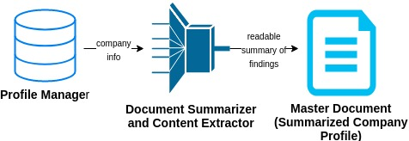
Milestone 2

Slide 33
Questions?

